Slide 1

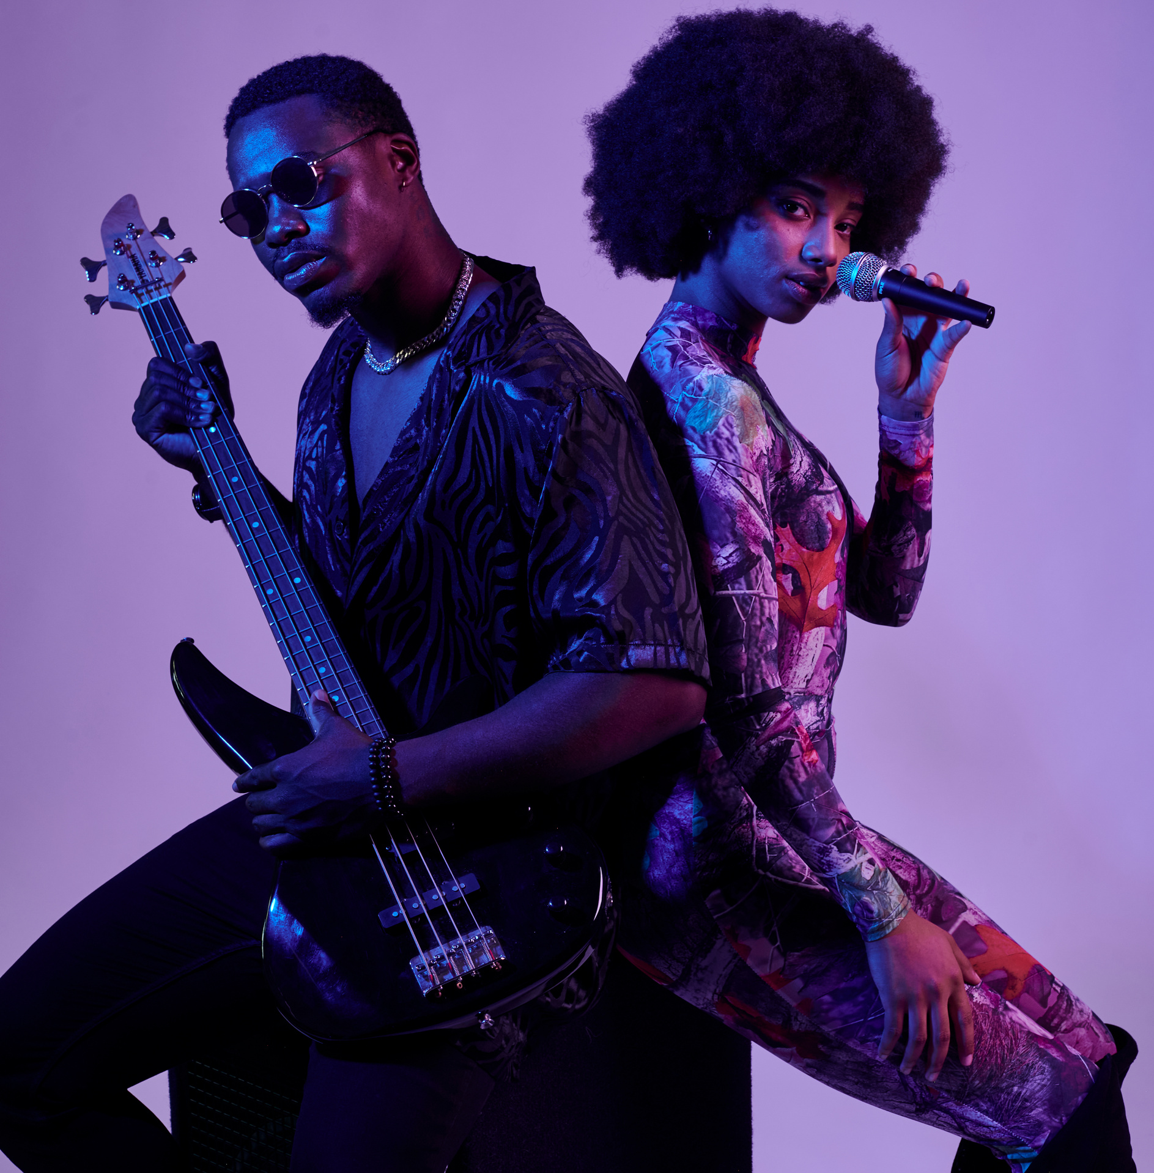
Analysis
SPOTIFY DANCE MUSIC
LEON BITTIS
SERGEJ KURTASCH

Slide 2





Project Overview
Dataset and Its Origin
6 tables from kaggle.com
5.7 million electronic music tracks with features.
9 characteristics of tracks, such as loudness, duration, mood, danceability etc.
Business Problem
identify correlation between characteristics and popularity
formulate recommendations for successfully promoting new releases

Slide 3

Challenges
1. High execution time for each operation with the DB.
2. Data cleaning and unification of data types.
3. Organizational solutions for linking tables via foreign keys.

Slide 4


DATABASE DESIGN
Database Design

Slide 5
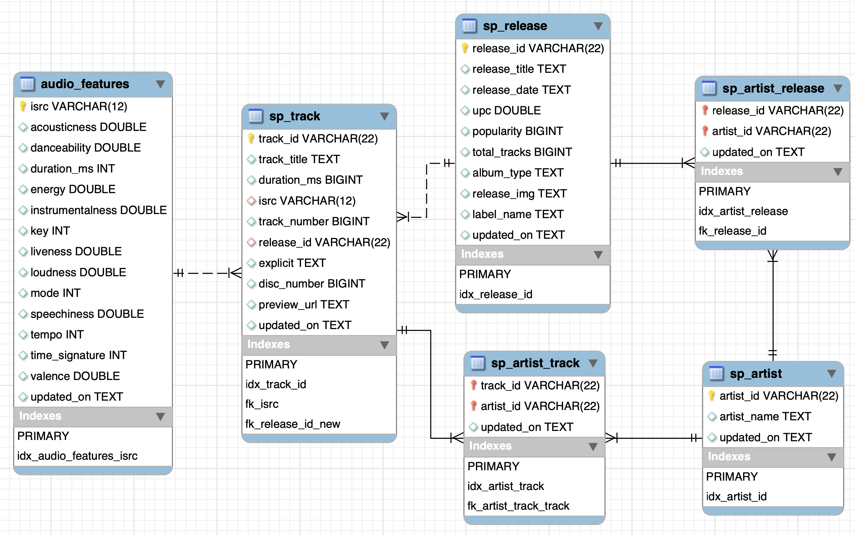
Database Design

Slide 6

DATA ANALYSIS

Slide 7
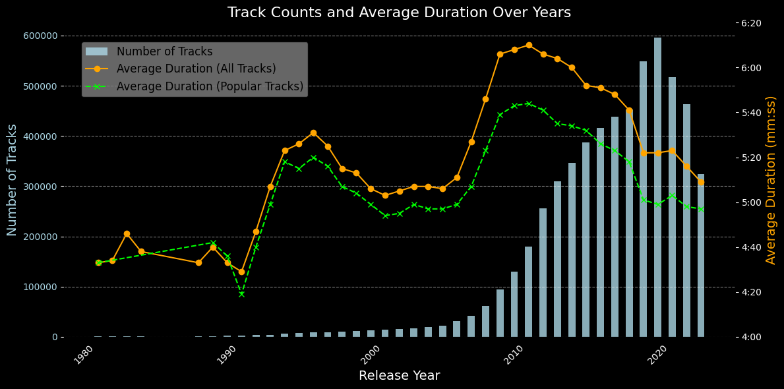
Average Duration Over Years
OF THE MONTH

Slide 8
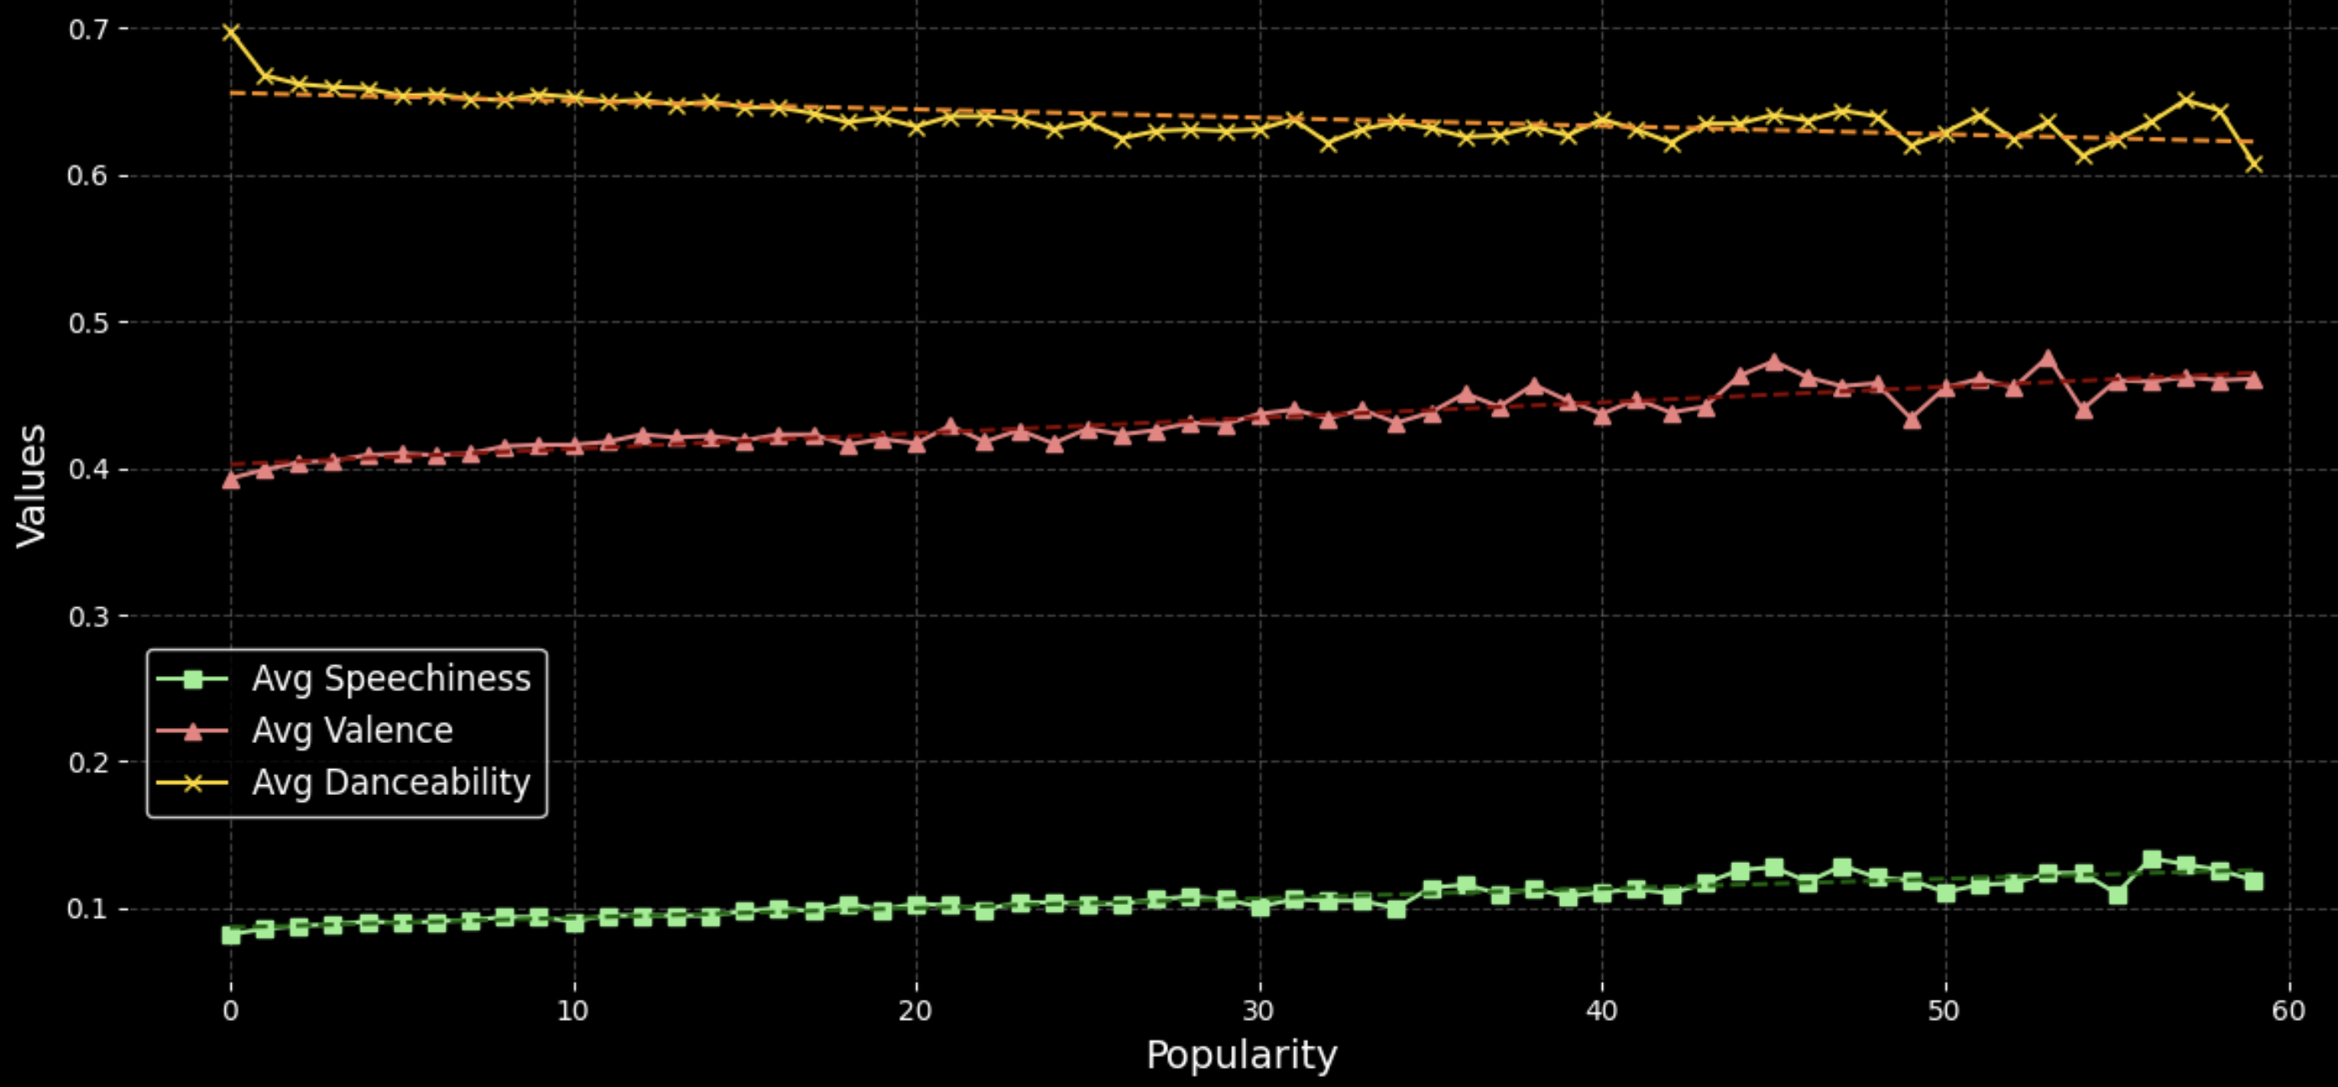
Audio Features vs Popularity
OF THE MONTH

Slide 9
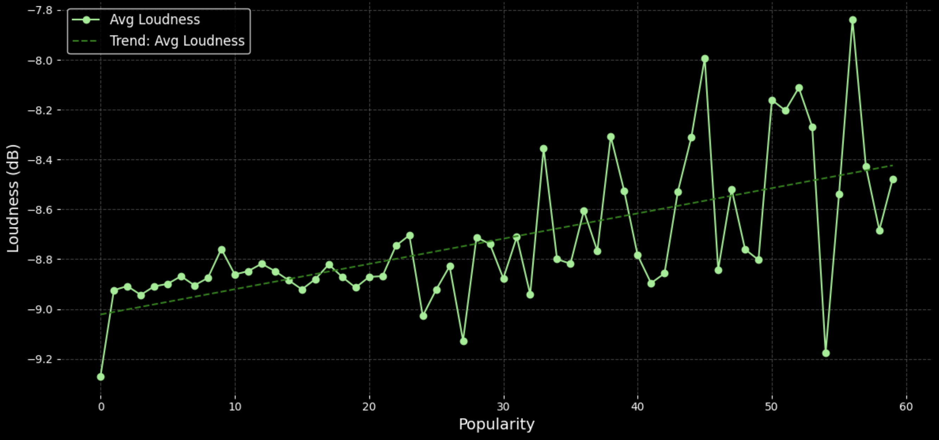
Loudness vs Popularity
OF THE MONTH

Slide 10
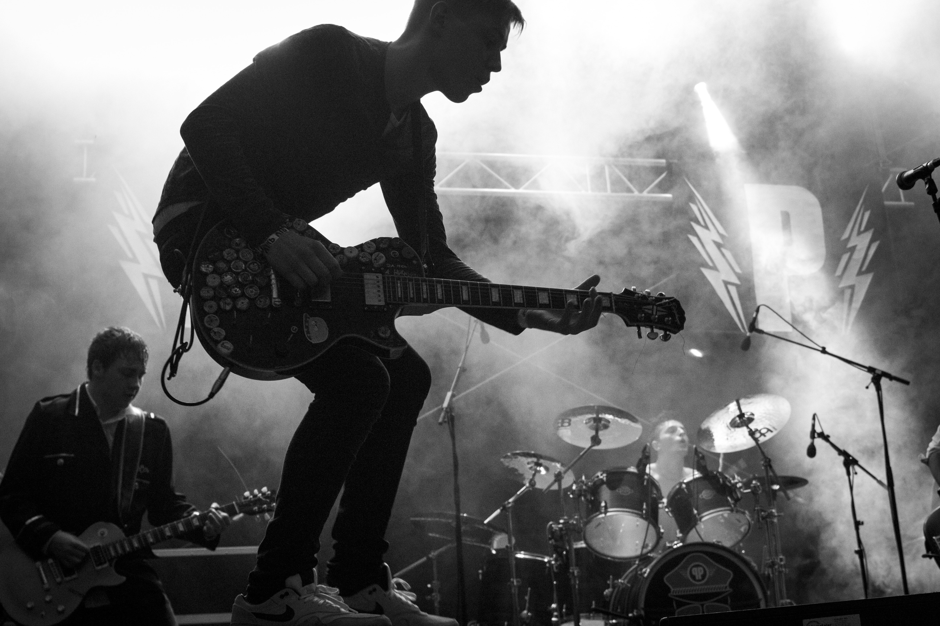


R
E

Slide 11
CONCERT VISITOR
STATISTICS

Slide 12
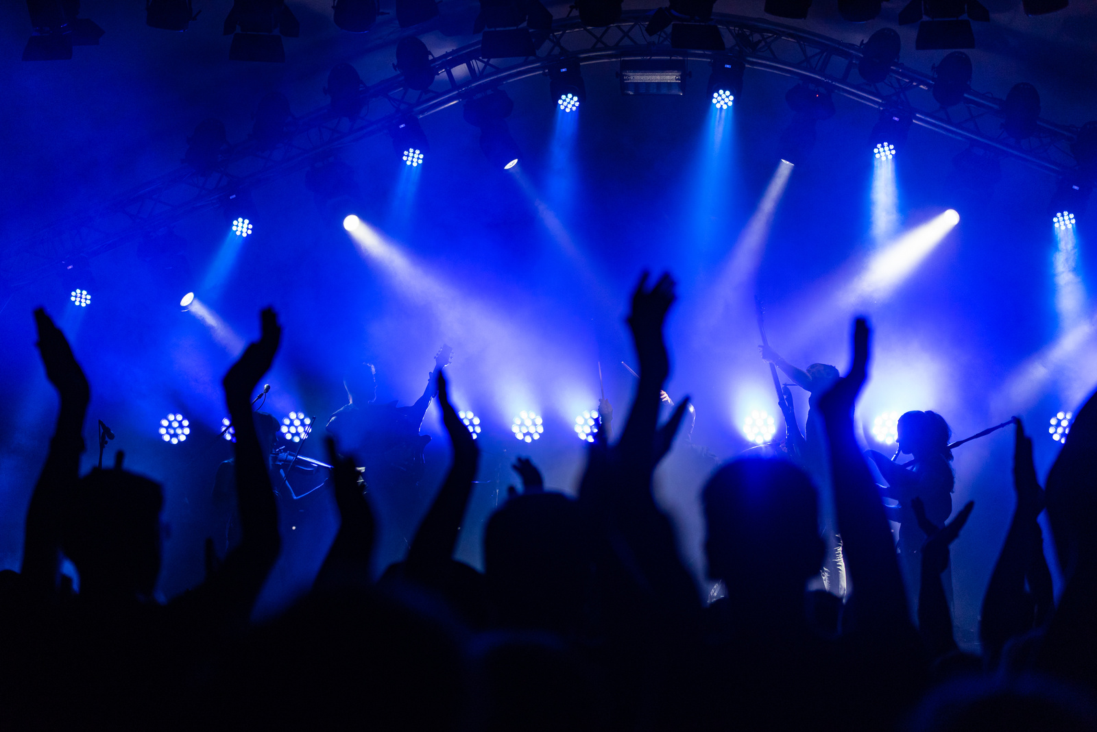
Conclusions &
Factors Positively Influencing Popularity
Text Readability: Lyrics that are clear and easy to follow.
Moderate Loudness: Balanced sound levels that are neither too loud nor too soft.
Danceability: Tracks that encourage movement and have rhythmic appeal.
Below-Average Track Duration: Shorter tracks tend to perform better.

Slide 13


THANK'S FOR WATCHING
LEON BITTIS
SERGEJ KURTASCH

